Slide 1







NU
WELLNESS
APP
Shuojun Chen
Weiwei Liu

Slide 2


Problem/Opportunity:
NU Students face significant mental health challenges: academic stress, career, cultural adaptation, homesickness, and often a sense of isolation
Where this idea comes from?
Resources for mental health support are limited and not paying that much attention
Solution:
NUwellness is a comprehensive mobile platform that combines practical productivity with mental wellness support.

Slide 3


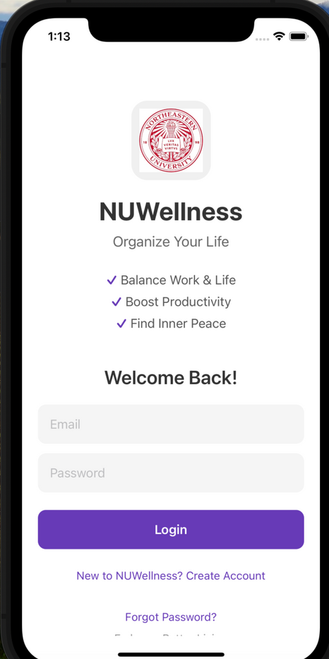


Main features we want to achieve
Authentication
· Users can sign up with email and password
· Sign out
· Forget password
· See your profile
Notes:
Problem/Opportunity:
At Northeastern University, students face mounting mental health challenges, particularly our international community who must navigate additional pressures like cultural adaptation and homesickness. While mental health resources exist on campus, they're limited and often don't fully address the diverse needs of our international students.
Solution:
NUwellness is a comprehensive mobile platform that combines practical productivity with mental wellness support. The app features: a versatile to-do list system and essential wellness tools.

Slide 4
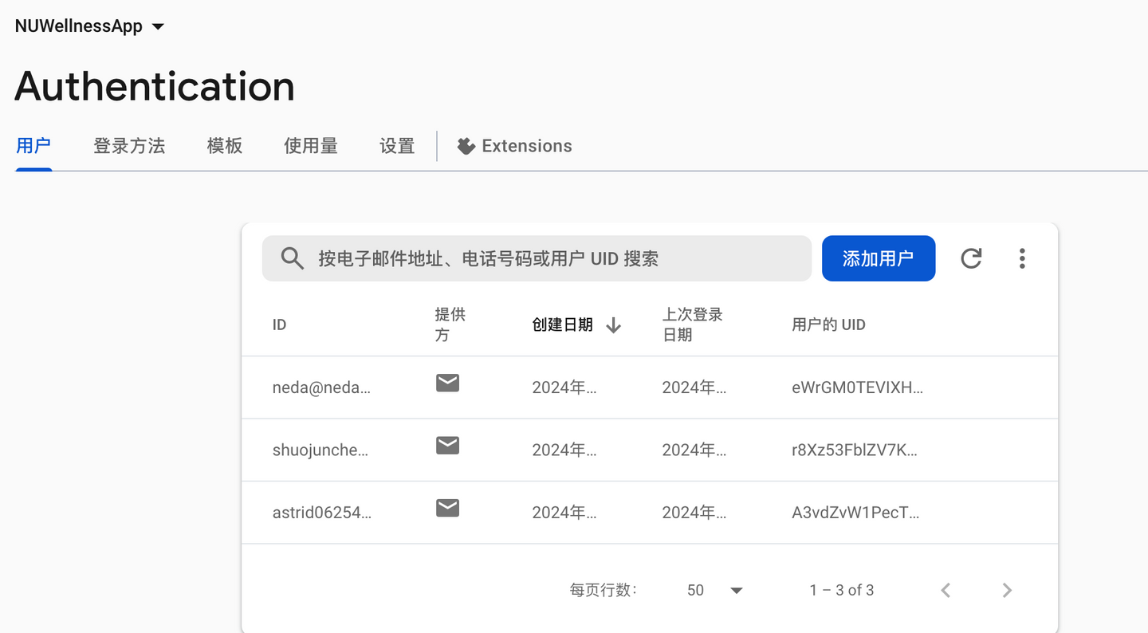
Main features we want to achieve
Store in firebase
ensure the user dats

Slide 5
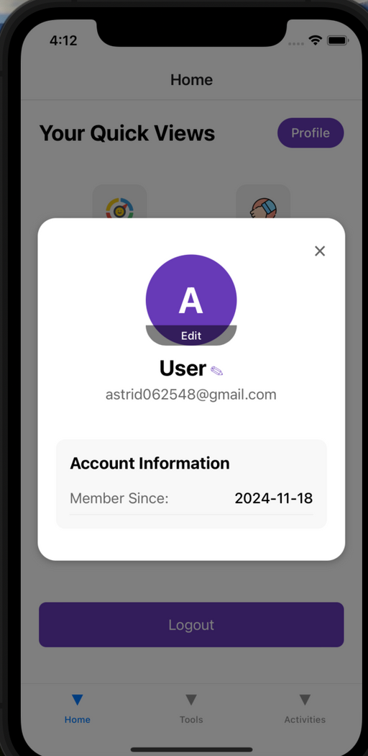
Main features we want to achieve
Check the profile

Slide 6
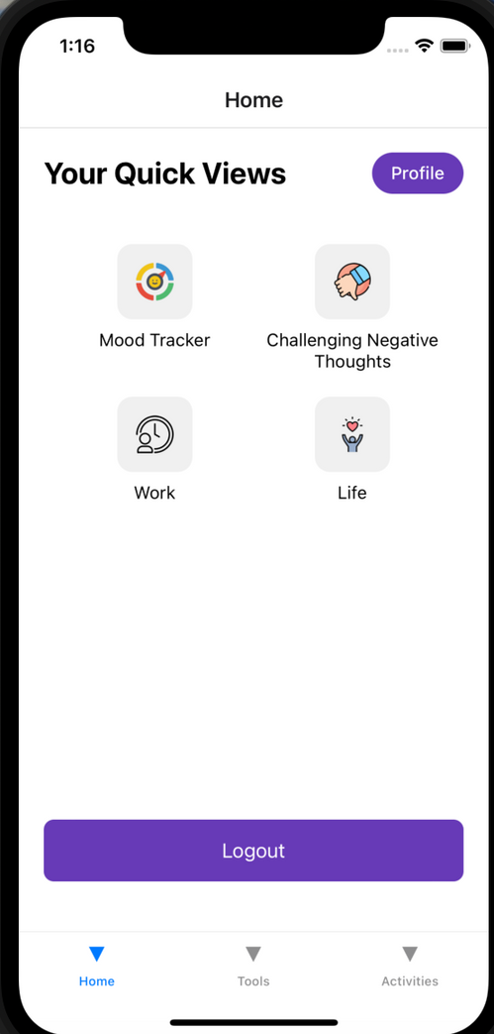

Main features we want to achieve
Quick View
· A personalized dashboard
· Each feature is associated
with a unique icon
· Easily click in and navigate

Slide 7
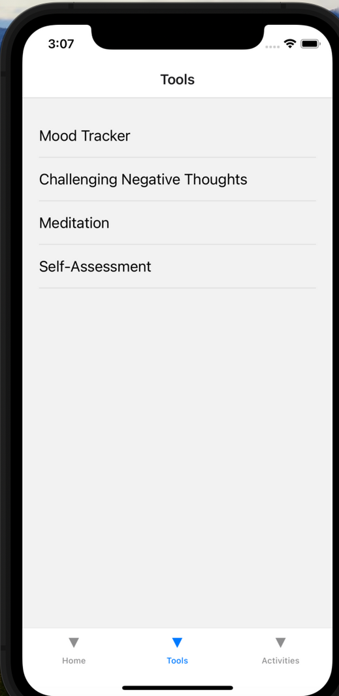
Main features we want to achieve
Tools
· Mood Tracker
· Challenging Negative Thoughts
· Meditation
· Self-Assesment

Slide 8
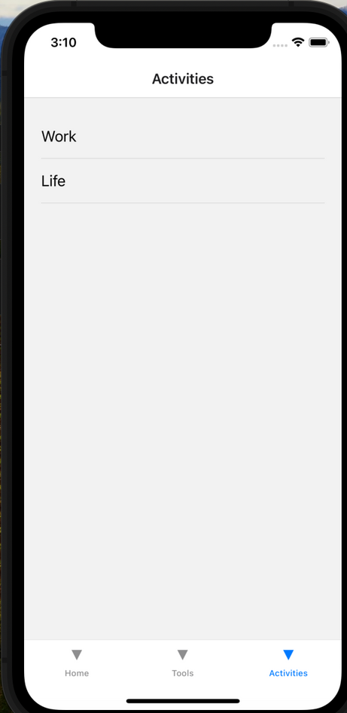
Main features we want to achieve
Activities
To do list for work and life

Slide 9

Tools-Mood Tracker
Mood Tracker
· Log daily moods (e.g., Good, Poor, OK) and write journals reflecting thoughts and feelings.
· Take photos directly from the app, providing a visual element to mood entries.
· Select wellness-related locations (e.g., meditation spots, parks) on an interactive map using OpenStreetMap API.

Slide 10
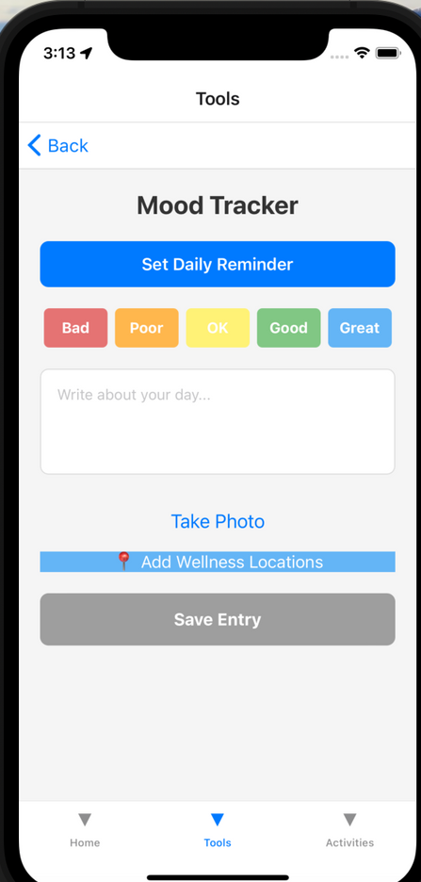


Tools-Mood Tracker
have reminder notification
choose the daily energy level
write journals
take a photo to record the moment
select the location

Slide 11
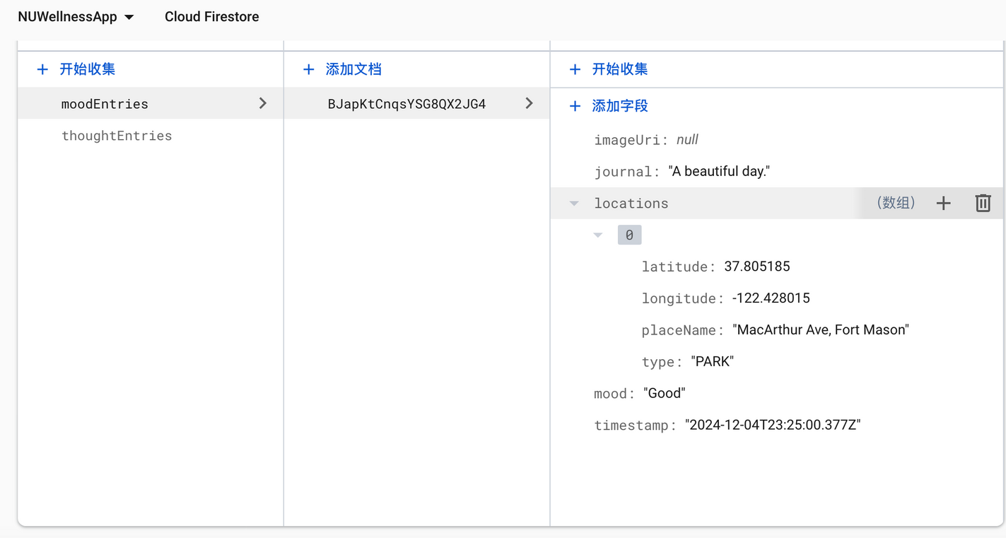
Tools-Mood Tracker
save the entry and store in database

Slide 12
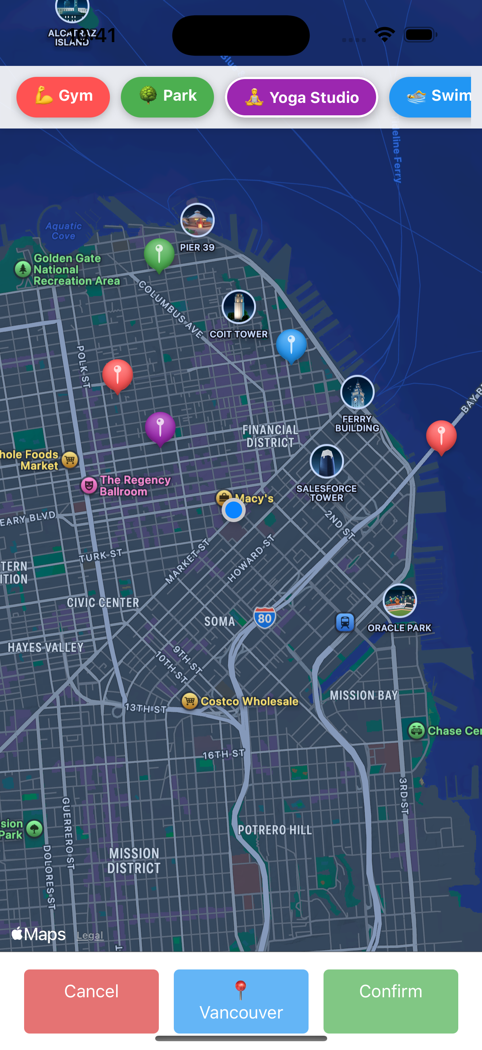
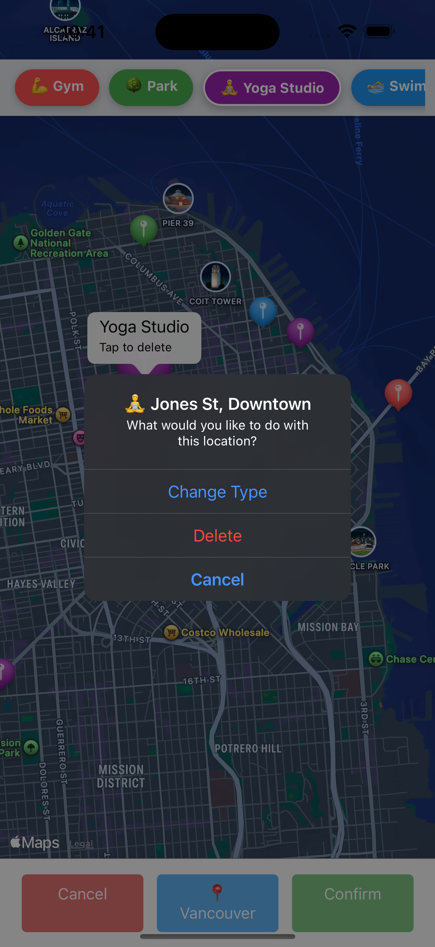
Location Map
Map set default to Vancouver
Multiple types of wellness facilities
Show the location name
Allow change and delete the marker
API: Open Street Map

Slide 13

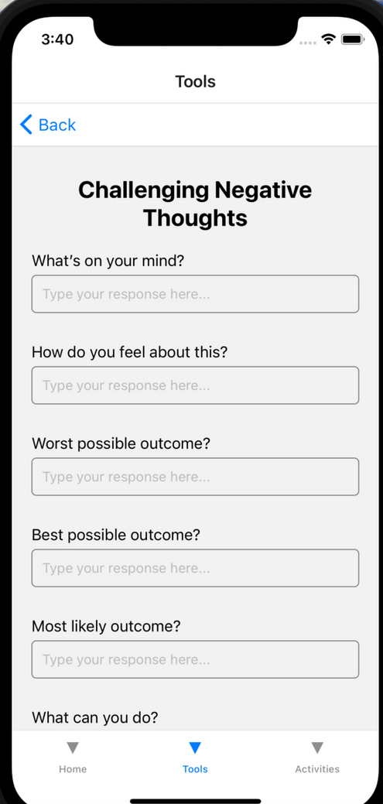

Tools-Challenging Negative Thoughts
Offers guided prompts to help users challenge unhelpful thinking patterns and reframe their mindset.

Slide 14
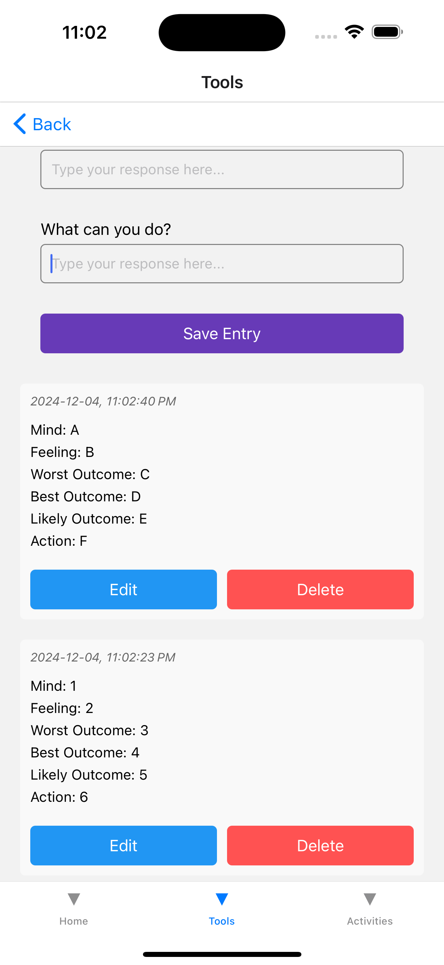
Tools-Challenging Negative Thoughts
check, edit, and delete the entry

Slide 15
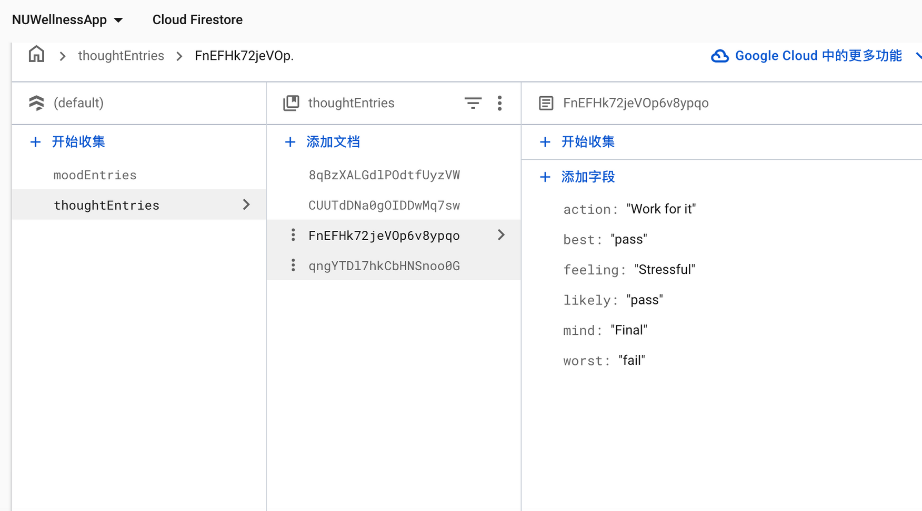
Tools-Challenging Negative Thoughts

Slide 16
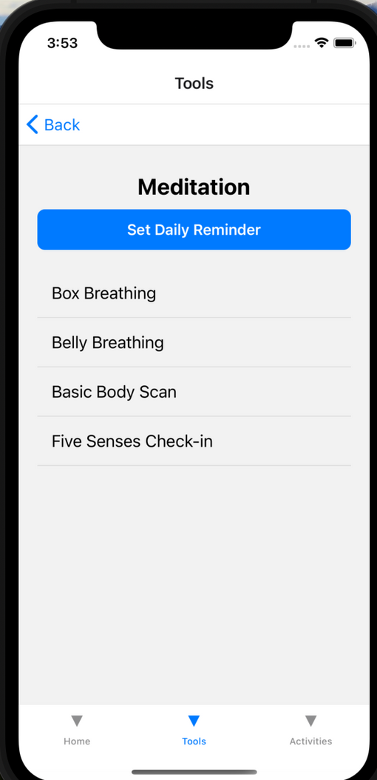
Tools-Meditation
Provides step-by-step guidance for simple mindfulness exercises.
Integrates daily reminders to encourage consistent practice.

Slide 17
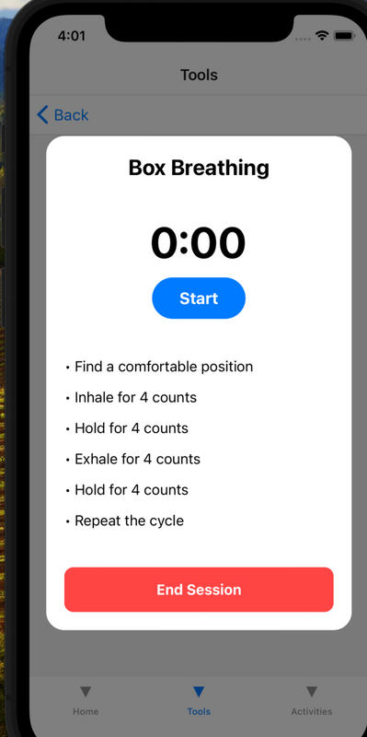
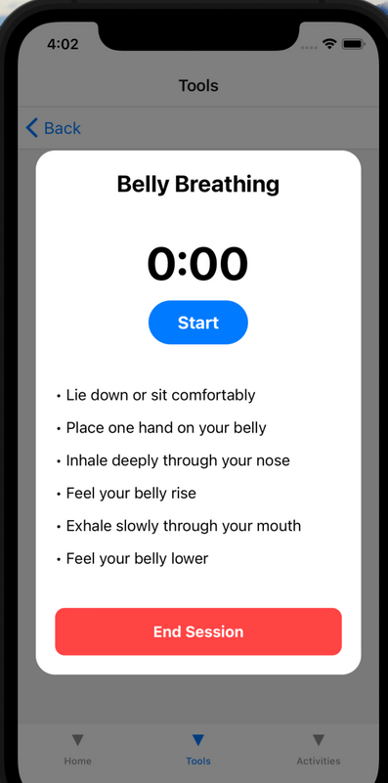
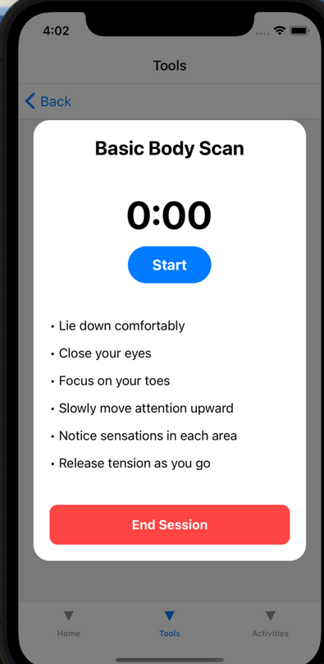
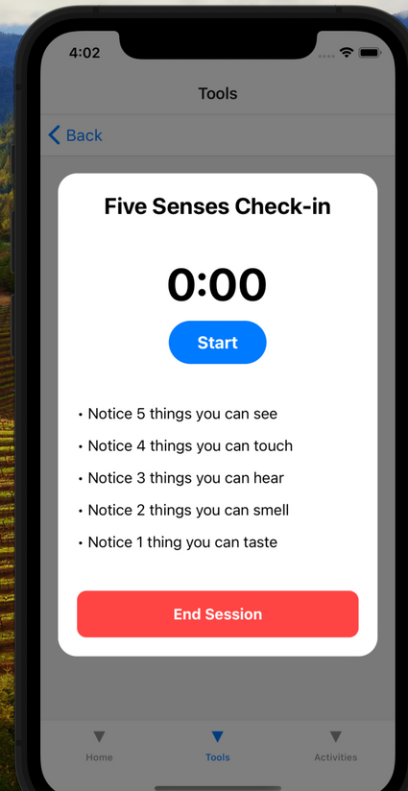
Tools-Meditation

Slide 18
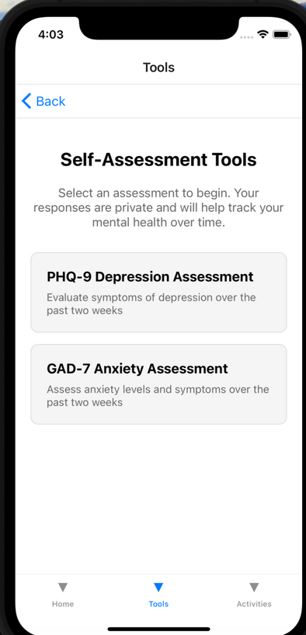
Tools-Self-Assesment
To give users tools for self-reflection and preliminary assessment of their mental health status.

Slide 19
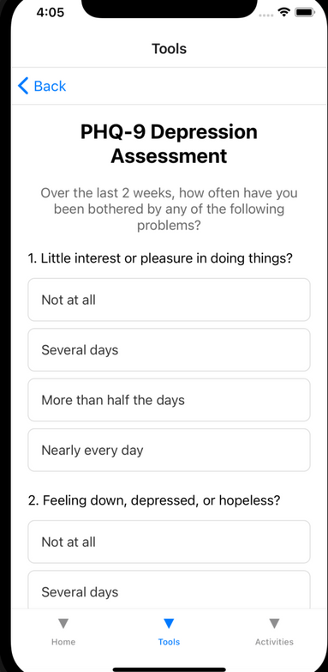
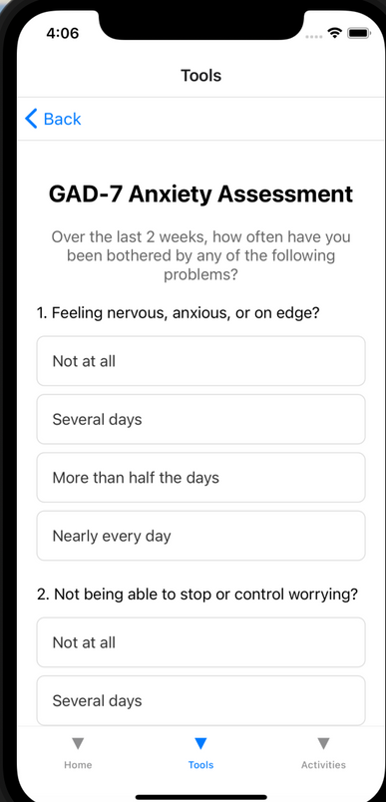
Tools-Self-Assesment
PHQ-9 and GAD-7 questionnaires
Standardized tools for assessing symptoms of depression and anxiety, respectively.
Results provide insights into the severity of mental health concerns.

Slide 20
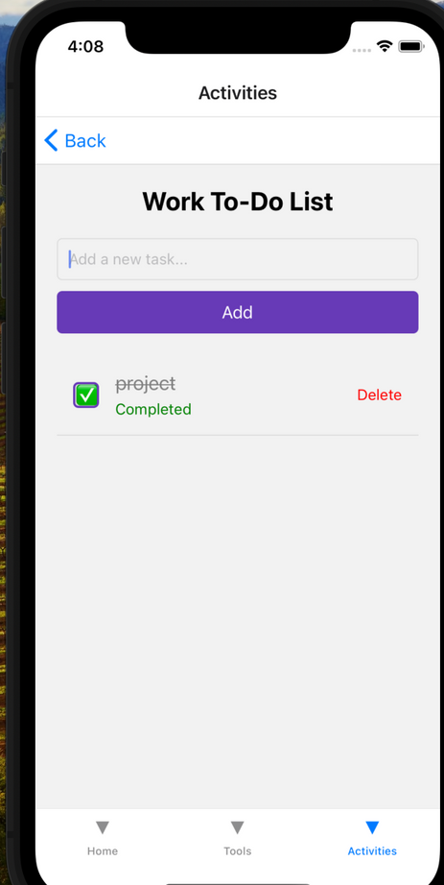
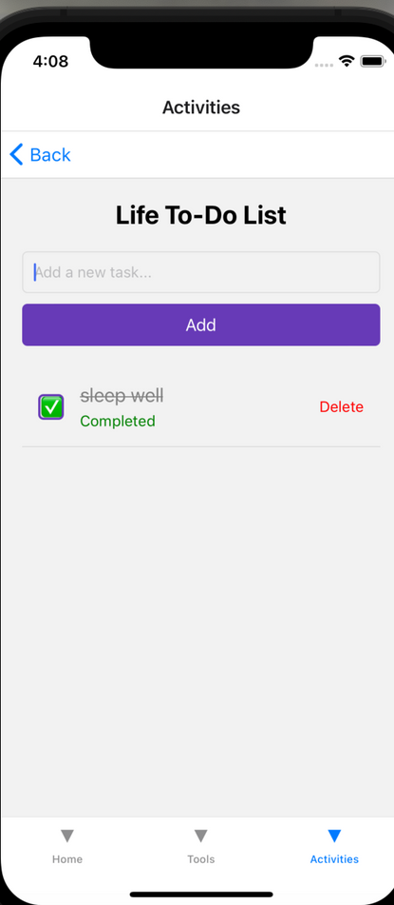
Activities
To-Do Lists: Work and Life Organization

Slide 21
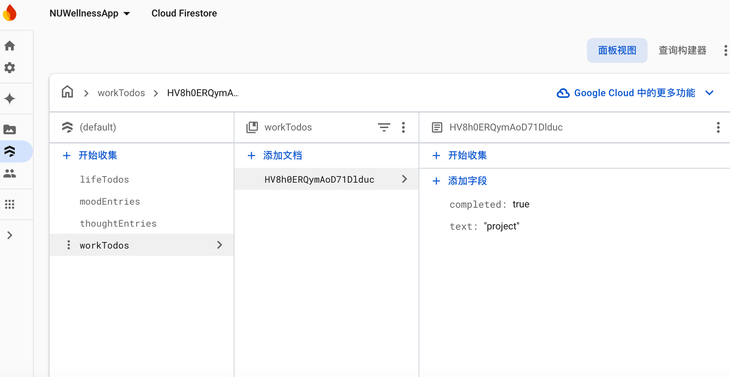
Activities

Slide 22
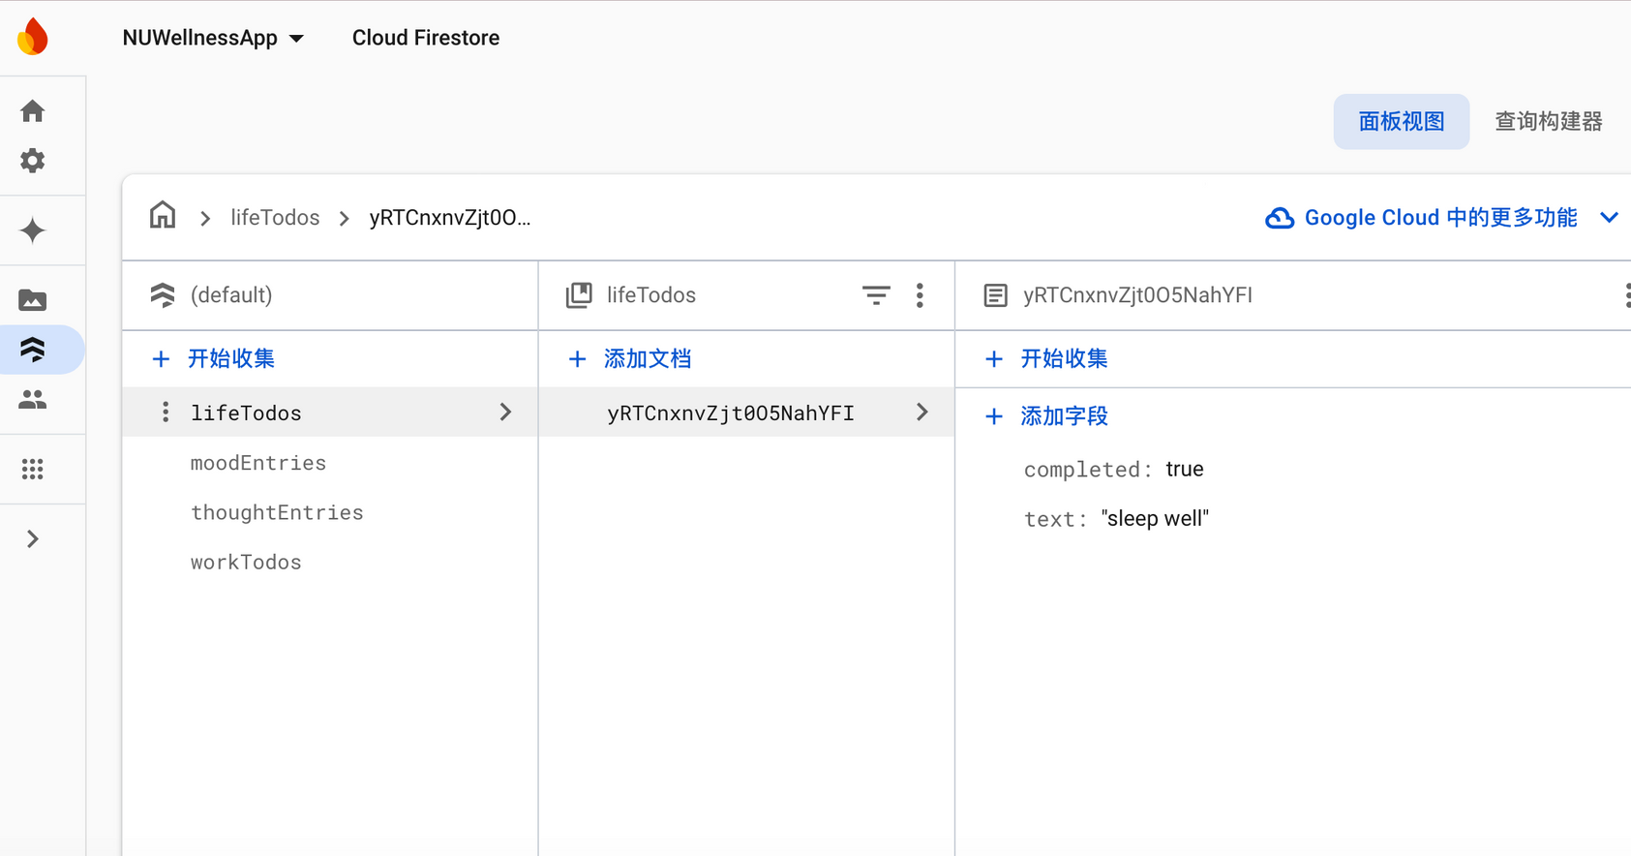
Activities

Slide 23
Reflection
What to be proud of:
Addressing a real need
Integration of features
Accessibility
User-centric approach
Challenges:
Design decisions
User experience
Feature prioritization
User privacy

Slide 24



Thank you!
We are on the way for self love

